Slide 1
Page Setup
Set up the first page of every lesson like this and rule a column line for every page after the first page that is used during the lesson.
Focus: State the Chapter Number, Title and the page numbers (3 lines).
Keywords: During the lesson write out your own keywords used during the lesson. (8 lines)
Context: During the lesson write in this section what this topic relates to in the ‘real’ world. How is this content used to better society? (5 lines)

Slide 2
Wave Properties
Chapter 10.1 Pages 312-318
2 lessons

Slide 3

An oscillation and a wave
An oscillation is a time-varying disturbance. A wave is a time-varying disturbance that also propagates in space.
All waves involve energy being transferred from one location to another without any net transfer of matter.
The particles within the wave oscillate around a set centre. This centre does not change.

Slide 4
Two Categories of Waves
Mechanical waves, e.g. sound, require a medium due to the particles need for a medium to travel. These include;
Transverse Waves
Longitudinal Waves
Non-mechanical waves, e.g. light, doesn’t need require a medium to travel. (Light can travel through a vacuum and also light can have mechanical properties).

Slide 5
Two Categories of Waves
Mechanical waves, e.g. sound, require a medium due to the particles need for a medium to travel. These include;
Transverse Waves
Longitudinal Waves

Slide 6
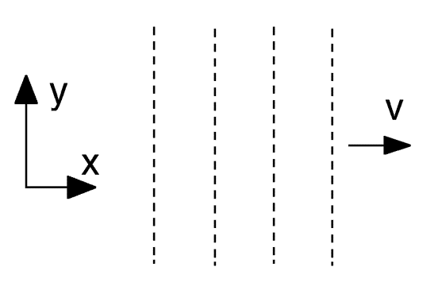
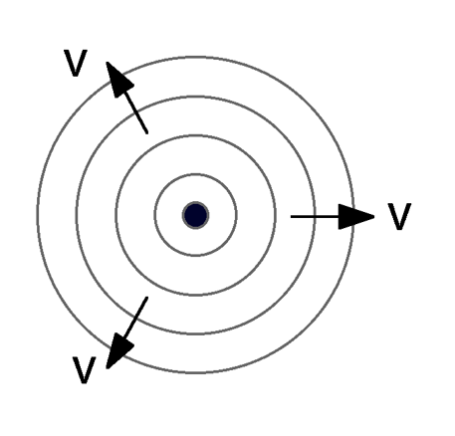
Basic Wave Front Concepts
Plane Wave Front
Spherical Wave Front
Surface of constant
disturbance, A, (or constant
phase) is a plane – i.e. peaks
and troughs form parallel planes.
Surface of constant phase is a sphere, with the wave source at the centre.

Slide 7

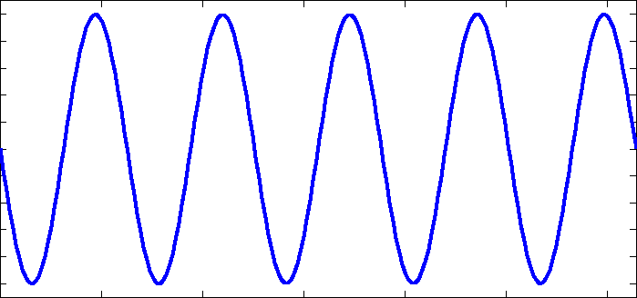
Waves
Wave Pulse Continuous Wave

Slide 8
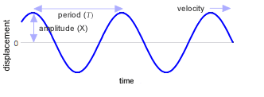
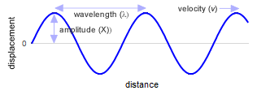
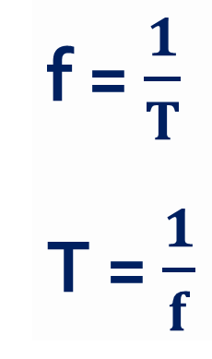
Amplitude, Frequency, Period, Speed and Wavelength
f = $\frac{1}{T}$
T = $\frac{1}{f}$

Slide 9
Amplitude, Frequency, Period, Speed and Wavelength
The wavelength (λ) is the distance between adjacent identical parts of the wave. For a sinusoidal wave this is the distance between troughs (crests).
Wavelength has a unit of distance (m).
The period (T) is the time taken for one complete up and down motion.
Period has a unit of time (s).

Slide 10

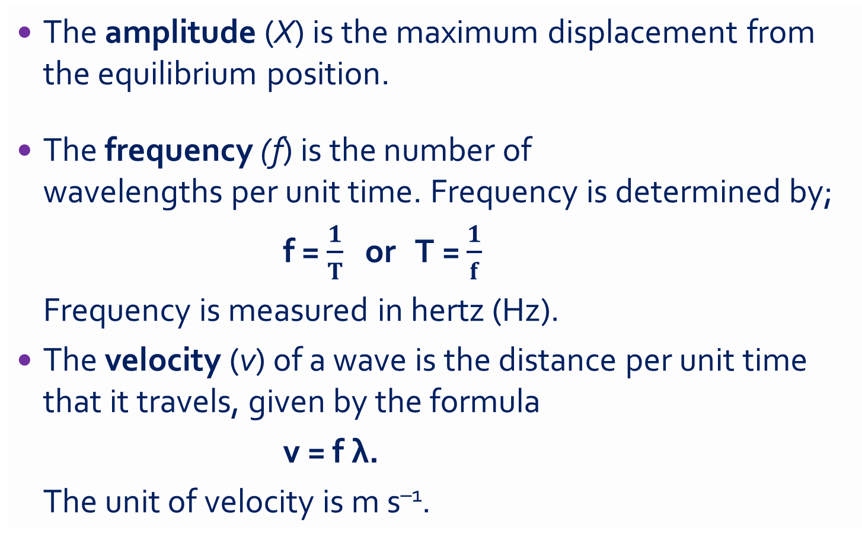
Amplitude, Frequency, Period, Speed and Wavelength
The amplitude (X) is the maximum displacement from the equilibrium position.
The frequency (f) is the number of
wavelengths per unit time. Frequency is determined by;
f = $\frac{1}{T}$ or T = $\frac{1}{f}$
Frequency is measured in hertz (Hz).
The velocity (v) of a wave is the distance per unit time that it travels, given by the formula
v = f λ.
The unit of velocity is m s^{–1}.

Slide 11
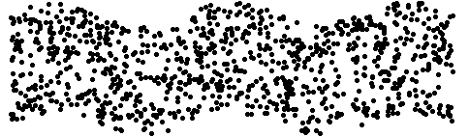

Transverse wave in a liquid
Longitudinal wave in a gas

Slide 12
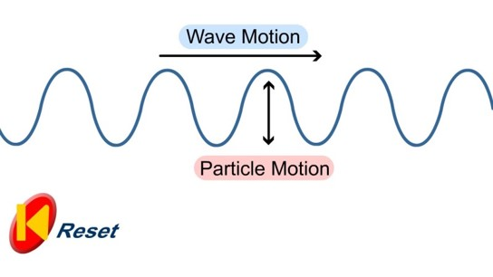
Transverse Mechanical Wave
Where particles vibrate in a direction perpendicular to that of the energy flow.
Examples: Electromagnetic (Light, Radio) waves and Water waves.

Slide 13
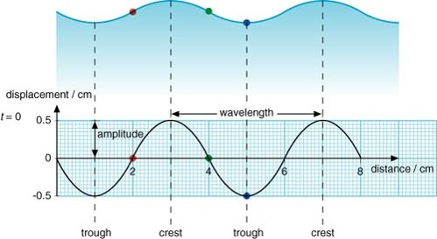
Transverse Mechanical Wave
The trough and crests are locations of maximum displacement.

Slide 14
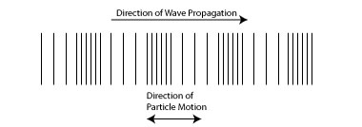
Longitudinal Mechanical Wave
Where particles vibrate in a direction parallel to that of the energy flow.
Examples: Sound waves

Slide 15
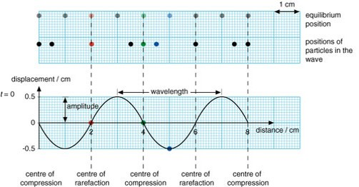
Longitudinal Mechanical Wave
The rarefaction and compression points are locations of maximum pressure.

Slide 16
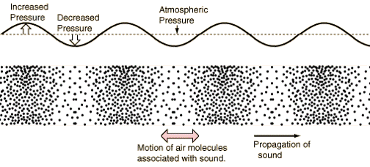
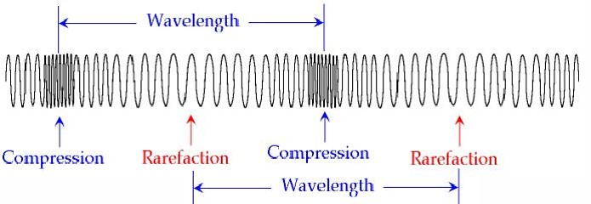
Longitudinal Mechanical Wave

Slide 17
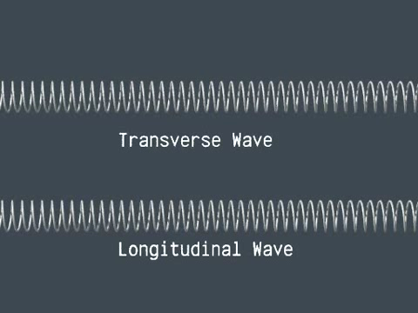
Transverse & Longitudinal Waves

Slide 18
Homework, Context & Keywords
Context: How is this content used to better society?
The understanding the principles behind wave energy better explains the fundamentals of light and sound

Slide 19
Homework, Context & Keywords
Key Words
Mechanical wave
Non-mechanical wave
Transverse
Longitudinal
Pulse wave
Continuous wave
Amplitude
Frequency
Period
Speed
Wavelength

Slide 20
Homework, Context & Keywords
Homework
Complete all questions from Set 10.1 - due first lesson next week.
Read Chapter 10.2, page 319-321 and answer
Q1 Set 10.2
by next lesson.

Slide 21
Page Setup
Set up the first page of every lesson like this and rule a column line for every page after the first page that is used during the lesson.
Focus: State the Chapter Number, Title and the page numbers (3 lines).
Keywords: During the lesson write out your own keywords used during the lesson. (8 lines)
Context: During the lesson write in this section what this topic relates to in the ‘real’ world. How is this content used to better society? (5 lines)

Slide 22
Sound Waves
Chapter 10.2 Pages 319-321

Slide 23
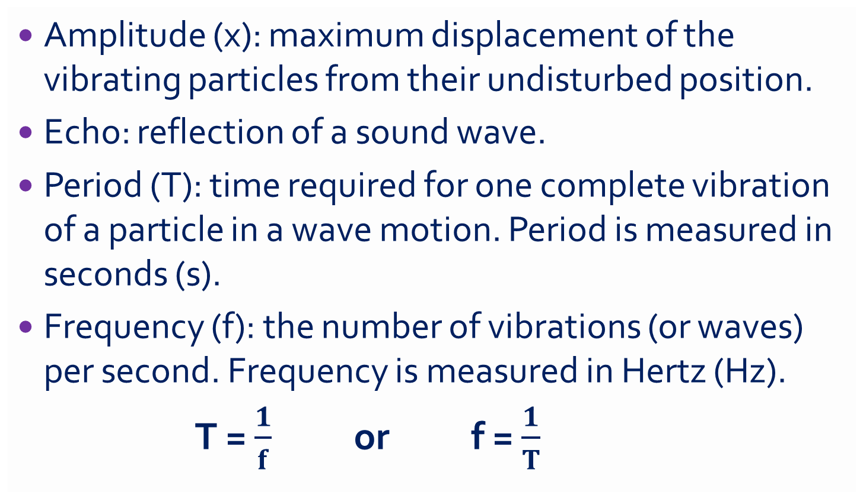
Terminology
Amplitude (x): maximum displacement of the vibrating particles from their undisturbed position.
Echo: reflection of a sound wave.
Period (T): time required for one complete vibration of a particle in a wave motion. Period is measured in seconds (s).
Frequency (f): the number of vibrations (or waves) per second. Frequency is measured in Hertz (Hz).
T = $\frac{1}{f}$ or f = $\frac{1}{T}$

Slide 24
Terminology
Reverberation: multiple echoes of the same sound.
Wavelength (λ): the distance between any two consecutive points in a wave which are in phase. Wavelength is measured in metres.
Phase: the stage of vibration that a particle has reached in its cycle of motion.
Pitch is what we hear change as frequency changes.
Velocity (v): the speed with which a progressive wave travels through a medium. Velocity measures in m s⁻¹.
v = f λ

Slide 25
Speed of Sound (in substances)
Substance | Conditions | Speed
Air | Dry, 25 ºC, 101.3 kPa | 346 ms⁻¹
Helium | 25 ºC, 101.3 kPa | 985 ms⁻¹
Oxygen | 25 ºC, 101.3 kPa | 330 ms⁻¹
Glycerol | 25 ºC | 1900 ms⁻¹
Water (distilled) | 25 ºC | 1500 ms⁻¹
Water (sea) | 25 ºC | 1530 ms⁻¹
Cork (thin rod) | 25 ºC | 500 ms⁻¹
Glass (thin rod) | 25 ºC | 4340 ms⁻¹
Aluminium (thin rod) | 25 ºC | 5000 ms⁻¹
Lead (thin rod) | 25 ºC | 1200 ms⁻¹
Soft Iron (thin rod) | 25 ºC | 5200 ms⁻¹

Slide 26
Speed of Sound (in substances)
Depends on two factors
Density – The more dense, the slower the sound travels, as the vibrations take more time to travel a set distance, passing from one particle to another.
Stiffness (elasticity) – the ability of a medium to return to its original shape, after disturbance.

Slide 27
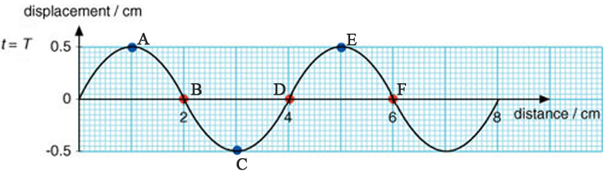
Example 10.2 a
Answer the following, giving appropriate units.
The wavelength (λ) is _______
The amplitude (x) is _______
List points in phase: _________________
List points in “completely” out of phase: ____________
a) 0.04 m
b) 0.005 m
c) A, E and B,F
d) A,C

Slide 28

Example 10.2 a
Answer the following, giving appropriate units/
List points with maximum upwards velocity: ________
If the frequency (f) is 2 Hz, what is the period (T)?
What is the speed of the wave at 2 Hz?
e) B, F
f) T = $\frac{1}{f}$ = $\frac{1}{2}$ = 0.5 s
g) v = λ × f = 0.04 × 2 = 0.08 m s⁻¹

Slide 29
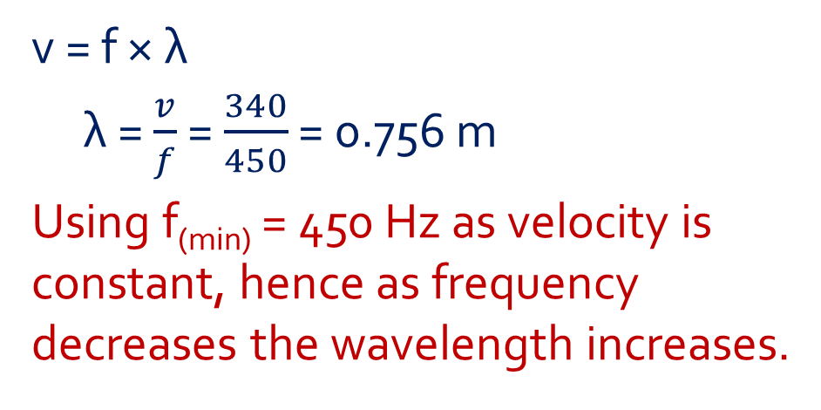
Example 10.2 b
One of the loud speakers from a sound system is capable of producing good quality sound in the frequency range of 450 – 4000 Hz. Assuming the speed of sound is 340 m s⁻¹, find;
The maximum distance between the compression waves emitted by this speaker.
v = 340 m s⁻¹
f_{(min)} = 450 Hz
f_{(max)} = 4000 Hz
v = f × λ
λ = $\frac{v}{f}$ = $\frac{340}{450}$ = 0.756 m
Using f_{(min)} = 450 Hz as velocity is constant, hence as frequency decreases the wavelength increases.

Slide 30
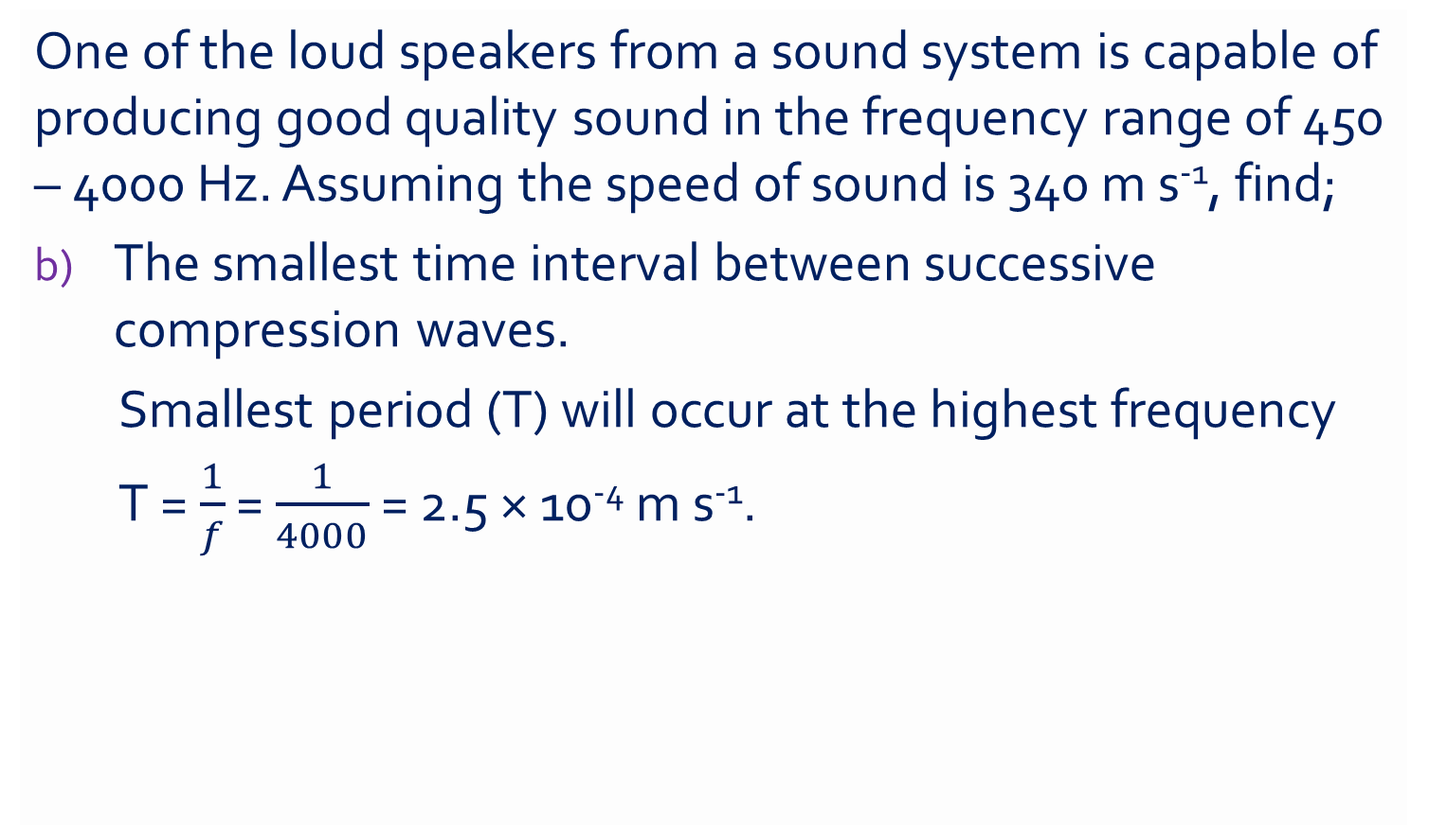
Example 10.2 b
One of the loud speakers from a sound system is capable of producing good quality sound in the frequency range of 450 – 4000 Hz. Assuming the speed of sound is 340 m s⁻¹, find;
The smallest time interval between successive compression waves.
Smallest period (T) will occur at the highest frequency
T = $\frac{1}{f}$ = $\frac{1}{4000}$ = 2.5 × 10⁻⁴ m s⁻¹.

Slide 31
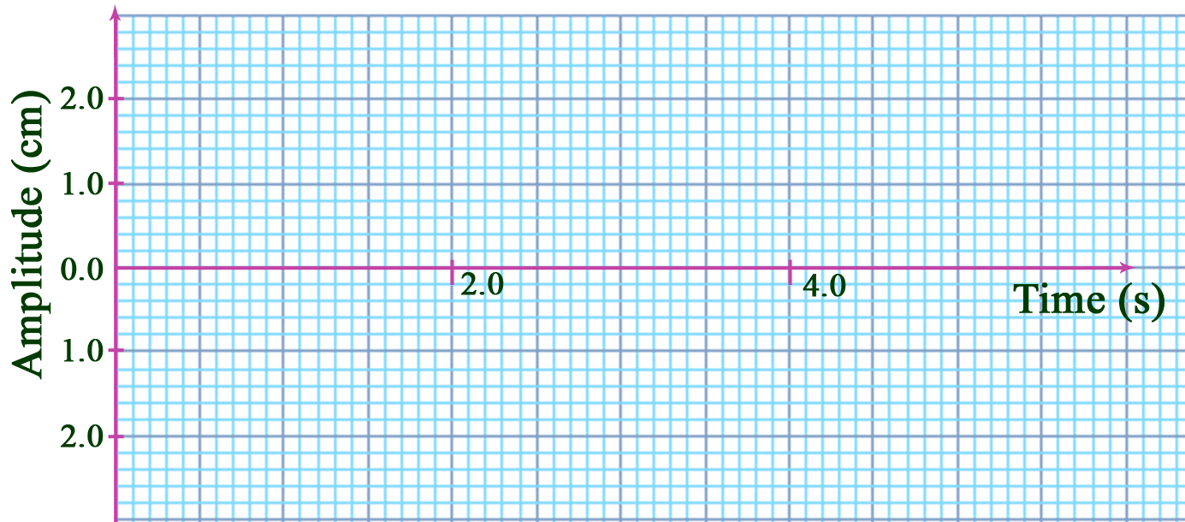
Example 10.2 c
Draw a wave form of period 2.0 seconds and amplitude 1.0 cm. On the same graph draw another wave form of period 2.0 seconds but with an amplitude 2.5 cm and out of phase by 180º.
Advanced: Then on the same axis, draw the resultant wave.

Slide 32
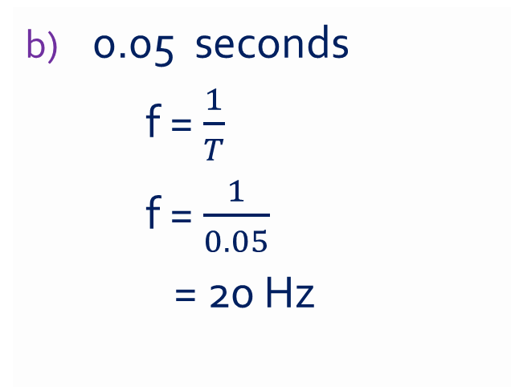
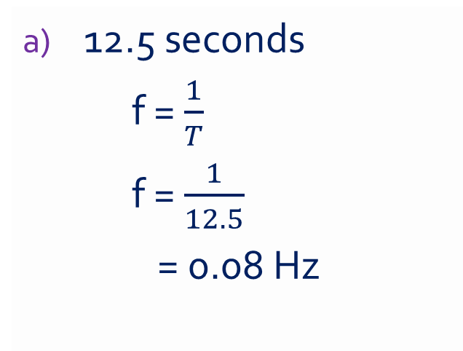
Example 10.2 d
Calculate the frequencies for waves of periods.
12.5 seconds
f = $\frac{1}{T}$
f = $\frac{1}{12.5}$
= 0.08 Hz
0.05 seconds
f = $\frac{1}{T}$
f = $\frac{1}{0.05}$
= 20 Hz

Slide 33
Example 10.2 e
A small stone is thrown onto the surface of a still pond of water. After 5 seconds thirty waves are seen to cover a distance of 2 metres from the centre. Calculate the wavelength, speed and frequency of the waves in the water.
Solution
Frequency: 5 seconds = 30 waves, hence in 1 second there are 6 waves. Thence the frequency is 6 Hz.
Wavelength: 30 waves across 2 metres. Hence the wavelength is 2 ÷ 30 = 0.067 m per wave
Velocity: c = f x λ = 6 x 0.067 = 0.4 m s⁻¹.

Slide 34
Homework, Context & Keywords
Context: How is this content used to better society?
The understanding the principles behind wave energy better explains the fundamentals of light and sound

Slide 35
Homework, Context & Keywords
Key Words
Amplitude
Echo
Period
Frequency
Reverberation
Phase
Pitch
Velocity

Slide 36
Homework, Context & Keywords
Homework
Complete all questions from Set 10.2 - due first lesson next week.
Read Chapter 10.3, page 323-330 and answer
Q1&2 Set 10.3
by next lesson.

Slide 37
Page Setup
Set up the first page of every lesson like this and rule a column line for every page after the first page that is used during the lesson.
Focus: State the Chapter Number, Title and the page numbers (3 lines).
Keywords: During the lesson write out your own keywords used during the lesson. (8 lines)
Context: During the lesson write in this section what this topic relates to in the ‘real’ world. How is this content used to better society? (5 lines)

Slide 38
Wave Behaviours
Chapter 10.3 Pages 323-330

Slide 39
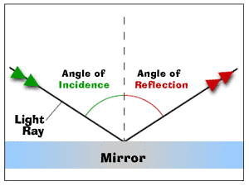
Reflection
When the wave does not pass through the solid barrier it encounters. The light ray that hits the mirror is called the incident ray. The light ray that bounces off the mirror is called the reflected ray.
Law of reflection
Angle of incidence (θ_{i}) = Angle of reflection (θ_{r})
Incidence ray and reflected ray are on the opposite sides of the normal.

Slide 40
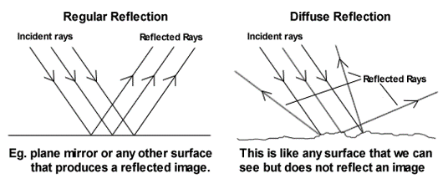
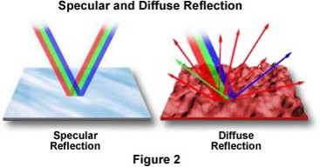
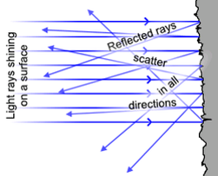
Reflection

Slide 41
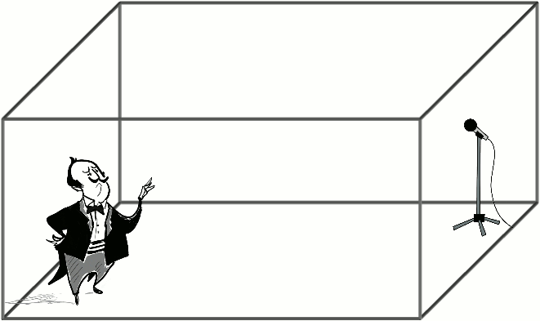
Reverberation

Slide 42
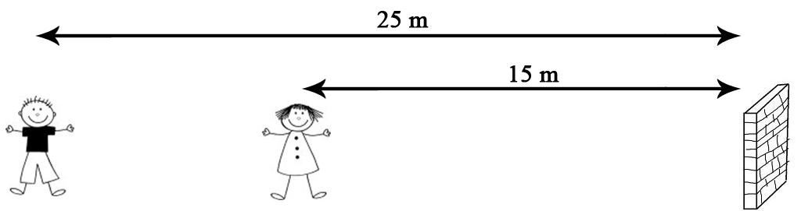
Example 10.3a
Jacob and Paula are standing 25 m and 15 m respectively from a large building when Jacob calls out loudly. Assume the speed of sound to be 340 ms⁻¹ and that good reflection of sound occurs from the building.
Draw a diagram illustrating the situation

Slide 43
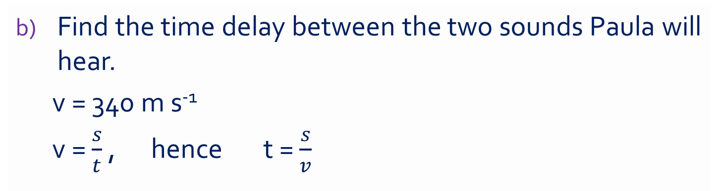
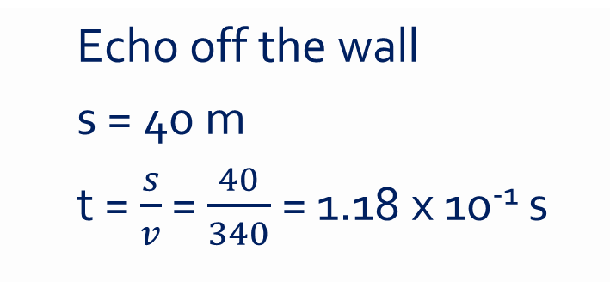
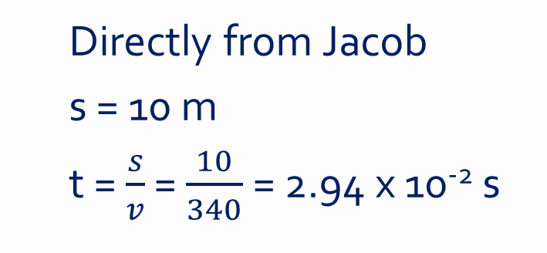
Example 10.3a
Find the time delay between the two sounds Paula will hear.
v = 340 m s⁻¹
v = $\frac{s}{t}$ , hence t = $\frac{s}{v}$
Directly from Jacob
s = 10 m
t = $\frac{s}{v}$ = $\frac{10}{340}$ = 2.94 x 10⁻² s
Echo off the wall
s = 40 m
t = $\frac{s}{v}$ = $\frac{40}{340}$ = 1.18 x 10⁻¹ s
Δt = t2 – t1 = 1.18 x 10⁻¹ - 2.94 x 10⁻² = 8.82 x 10⁻² s

Slide 44
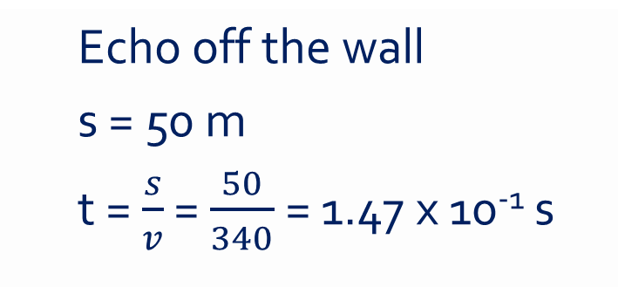
Example 10.3a
Will Paula hear an echo?
Unlikely, the two sounds that reach her are too close together.
Will Jacob detect the echo?
Directly from Jacob
s = 0 m
t = 0 s
Echo off the wall
s = 50 m
t = $\frac{s}{v}$ = $\frac{50}{340}$ = 1.47 x 10⁻¹ s
Δt = t2 – t1 = 1.47 x 10⁻¹ – 0 = 1.47 x 10⁻¹ s
It is likely he could hear an echo

Slide 45

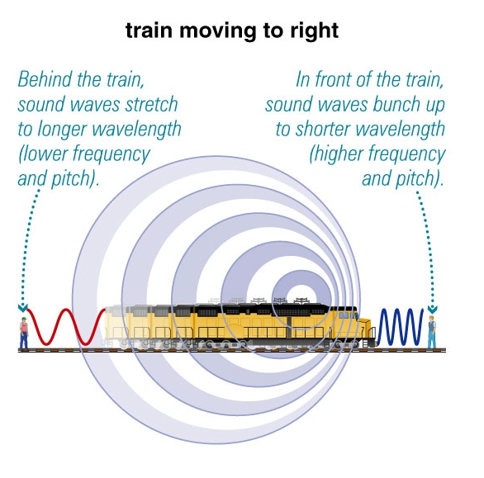
Doppler Effect

Slide 46
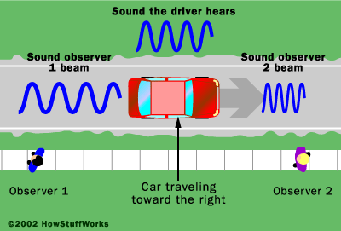




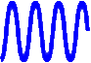
Doppler Effect
rdrgtfrdfg

Slide 47
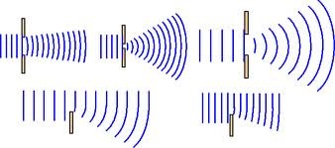
Diffraction
Waves are able to bend around obstacles or narrow openings.
Diffraction depends on
Size of wavelength (larger wavelengths diffract better than smaller wavelengths).
Size of opening (diffraction is greatest when the wavelength is greater than the opening).

Slide 48
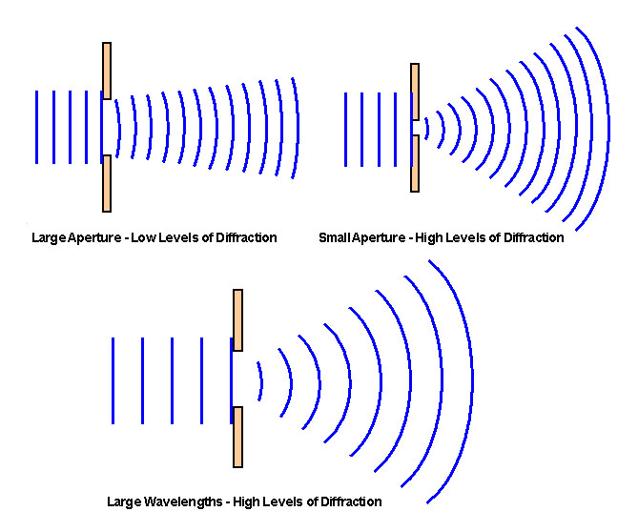
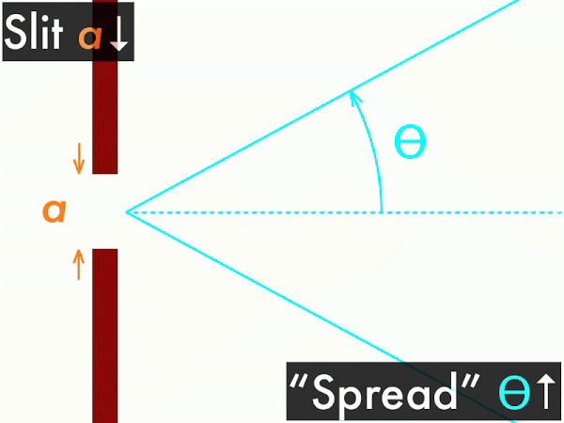
Diffraction

Slide 49
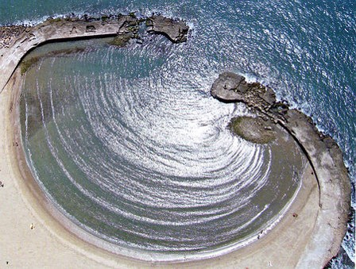
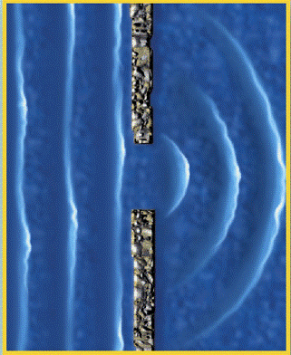
Diffraction
Wavelength can also be influenced by the type of medium propagating waves (e.g. water) and it’s viscosity and hydrogen bonding properties that gives it its “sticky” effects.

Slide 50
Example 10.3b
Sketch the appearance of the waves after they have encountered the obstacle or gap, as shown when D is equal to λ.
D
D
D
D

Slide 51
Refraction
Refraction can occur when the speed of a wave changes, as it moves from one environment (medium) to another. After refraction, the wave has the same frequency but a different speed, wavelength and direction.
When a wave enters a new environment, its change in speed will change its wavelength.
If the wave enters the new environment at any angle other than normal to the boundary, then the change in the wave's speed will also change its direction.

Slide 52
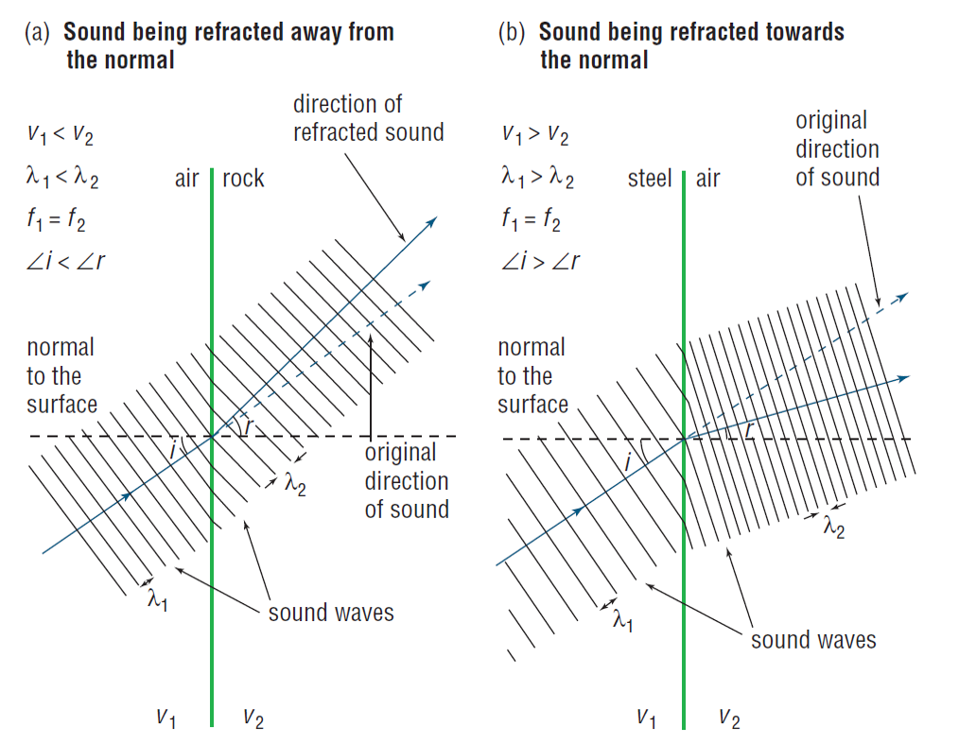
Refraction
Bends towards the normal where the speed slows as it enters a new medium.
Bends away from the normal where the speed increases as it enters the new medium.

Slide 53
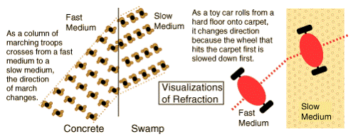
Refraction

Slide 54
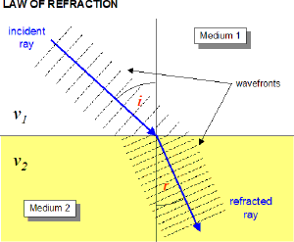
Refraction
v₁ > v₂
λ₁ > λ₂
Li > Lr
Hence “Medium 1” is a more solid medium than “Medium 2”.

Slide 55
Homework, Context & Keywords
Context: How is this content used to better society?
The understanding the principles behind wave motion better explains the fundamentals of sound.

Slide 56
Homework, Context & Keywords
Key Words
Reflection
Reverberation
Doppler
Diffraction
Refraction

Slide 57
Homework, Context & Keywords
Homework
Complete all questions from Set 10.3 - due first lesson next week.
Read Chapter 10.4, page 330-334 and answer
Q1, 2 & 3 Set 10.4
by next lesson.

Slide 58
Page Setup
Set up the first page of every lesson like this and rule a column line for every page after the first page that is used during the lesson.
Focus: State the Chapter Number, Title and the page numbers (3 lines).
Keywords: During the lesson write out your own keywords used during the lesson. (8 lines)
Context: During the lesson write in this section what this topic relates to in the ‘real’ world. How is this content used to better society? (5 lines)

Slide 59
Superposition
Chapter 10.4 Pages 330-334

Slide 60
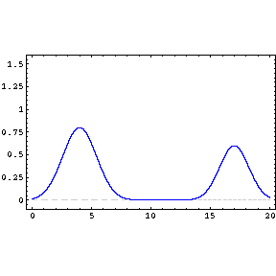
Superposition
Resulting displacement of two or more longitudinal or transverse waves.

Slide 61
Superposition
If two or more travelling waves are moving through some medium, the resultant wave displacement at any point is the algebraic sum of the individual wave displacements.

Slide 62
+
+
Beat:
When two different waves of different frequencies are added together to create a repetitive and constant rise and fall in intensity of sound.

Slide 63
Constructive Interference
These two waves arrive are IN PHASE
+

Slide 64
Destructive Interference
These two waves arrive in OUT OF PHASE (aka Anti-Phase)
+

Slide 65
Constructive Superposition

Slide 66
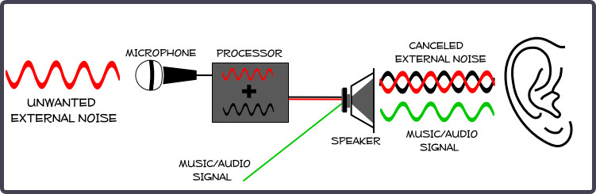
Superposition
Noise Reduction: Computers and microphones are used to reduce workplace noise. The microphone picks up the sound and the computer repeats the sound out of phase. Hence by destructive interference the noise is reduced.

Slide 67
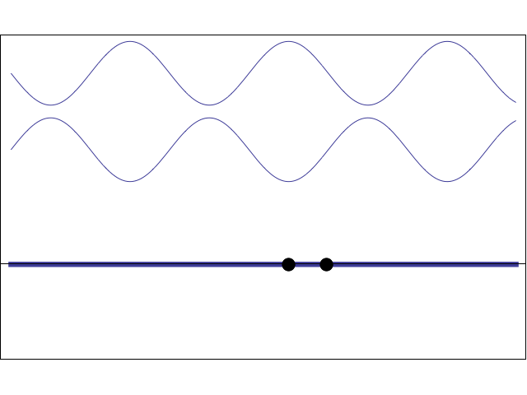
Standing Wave
Two counter-propagating travelling waves of same frequency and amplitude superpose to form a standing wave, characterised by
nodes (positions of zero disturbance) and
antinodes (positions of maximum disturbance)

Slide 68
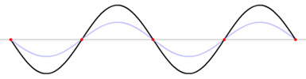
Standing Wave
ANTINODES
NODES
Node to Node = ½ λ
BETWEEN ANY PAIR OF ADJACENT NODES, ALL PARTICLES ARE MOVING IN PHASE

Slide 69
Forced vibrations
Forced vibrations are the result of a vibration caused by the continuous application of a repetitive force.
Free vibrations
Natural (or free) vibrations are the result of the “make up” of the object. Every object has a natural frequency. The natural frequency of a body depends on its elasticity and its shape.

Slide 70
Resonance
Occurs when the forced frequency equals the natural frequency of the object.
It is the maximum amplification which results in an obvious increase in sound or the destruction of an object (e.g. breaking glass with sound).
Unless the forcing frequency is equal to the natural frequency, the amplitude of oscillation will be small.
Effectively this repetitive force added to the natural frequency, becomes the building new natural frequency.

Slide 71
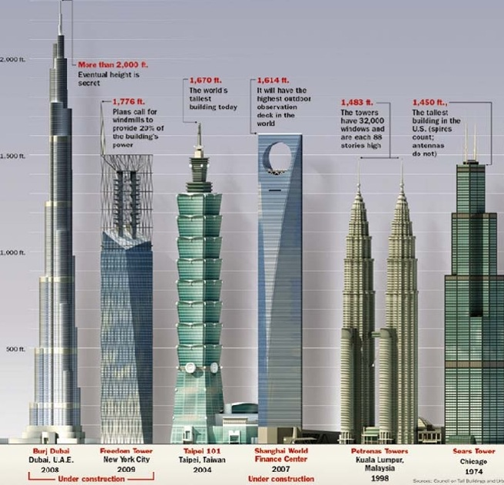
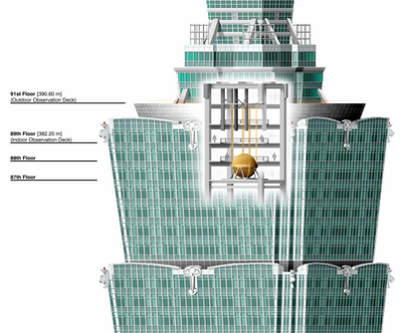
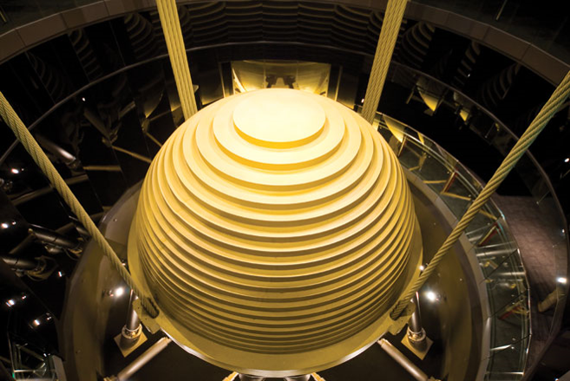
The 508m Taipei 101 Tower would sway back and forth up to 60cm each way within five seconds (Wired magazine). The Taipei 101 engineers included a 662 tonne counter giant pendulum to act as a counter weight. It is pushed in the opposite direction to the buildings sway to dampen the oscillation.

Slide 72
Homework, Context & Keywords
Context: How is this content used to better society?
The understanding of the principles behind vibrations in structures to better design sound and stable buildings.

Slide 73
Homework, Context & Keywords
Key Words
Superposition
Constructive
Destructive
Stationary
Resonance
Free vibration
Forced vibration
Resonance
Beat
Nodes
Anti-nodes

Slide 74
Homework, Context & Keywords
Homework
Complete all questions from Set 10.4 - due first lesson next week.
Read Chapter 10.5, page 334-336 and answer
Q1 Set 10.5
by next lesson.

Slide 75
Page Setup
Set up the first page of every lesson like this and rule a column line for every page after the first page that is used during the lesson.
Focus: State the Chapter Number, Title and the page numbers (3 lines).
Keywords: During the lesson write out your own keywords used during the lesson. (8 lines)
Context: During the lesson write in this section what this topic relates to in the ‘real’ world. How is this content used to better society? (5 lines)

Slide 76
Modes of Vibration
Chapter 10.5 Pages 334-336

Slide 77

Standing Harmonics
As the wave tightens the pitch increases

Slide 78

Standing Harmonics

Slide 79
Homework, Context & Keywords
Context: How is this content used to better society?
The principles behind wave energy to better explains the fundamentals of music and sound.

Slide 80
Homework, Context & Keywords
Key Words
Harmonics
Overtones

Slide 81
Homework, Context & Keywords
Homework
Complete all questions from Set 10.5 - due first lesson next week.
Read Chapter 10.6, page 334-342 and answer
Q1 Set 10.6
by next lesson.

Slide 82
Page Setup
Set up the first page of every lesson like this and rule a column line for every page after the first page that is used during the lesson.
Focus: State the Chapter Number, Title and the page numbers (3 lines).
Keywords: During the lesson write out your own keywords used during the lesson. (8 lines)
Context: During the lesson write in this section what this topic relates to in the ‘real’ world. How is this content used to better society? (5 lines)

Slide 83
Vibration Influences
Chapter 10.6 Pages 334-342

Slide 84
Vibrations in air columns
Air columns in pipes can be set vibrating by blowing across the open end (includes tuning forks and loud speaker).
The standing waves in an air column are the result of two similar waves travelling in opposite directions.
Open ended pipes are open at both ends and closed pipes are closed at one end.

Slide 85

Stationary Waves in Open Pipes
FUNDAMENTAL l = λ/2
1st harmonic
actual air vibration
1st overtone l = λ
2nd harmonic
2nd overtone l = 3λ/2
3rd harmonic
λ = 2L
n
f = nv
2L
where λ is the wavelength of the nth harmonic (m), l is the effective length of the air column (m) and n is the number of the harmonic = 1, 2, 3, ... v is the velocity of the component waves (ms^{–1}).

Slide 86

Stationary Waves in Closed Pipes
FUNDAMENTAL l = λ/4
1st harmonic
1st overtone l = 3λ/4
3rd harmonic
2nd overtone l = 5λ/4
5th harmonic
λ = 4L .
(2n – 1)
f = (2n – 1)v
4L
where λ is the wavelength of the nth harmonic (m), l is the effective length of the air column (m) and n is the number of the harmonic = 1, 3, 5, ... v is the velocity of the component waves (ms^{–1}).

Slide 87

Example 10.6a
A hearing test speaker emits
only one frequency at a time.
The output level is gradually
altered and a listener notes at
what sound level he can hear
the sound. The test is repeated for a range of frequencies and the results are plotted.
What sound level at 50 Hz gives the same perceived loudness as a level of 20 dB at 500 Hz?
If the sound level produced by the loudspeaker was held at a constant 40 dB while the frequency was varied, what range of frequencies would be heard?

Slide 88

Example 10.6b
An organ pipe produces sound at 250 Hz, 500 Hz amd 1000 Hz. Assuming the speed of sound is 330 m s⁻¹, determine;
If it is an open or closed pipe
Ratio of frequency harmonic = $\frac{500}{250}$ = 2
Ratio of frequency harmonic = $\frac{1000}{250}$ = 4
This shows the pipe only has even harmonics, hence it has to be an open pipe, as closed pipes can’t have even harmonics.
The length of the pipe
L = $\frac{n v}{2 f}$ = $\frac{1 ×330}{2 ×250}$ = 0.66 m

Slide 89

Example 10.6c
The two speakers below are producing 680 Hz note. Assume the speed of sound in the air is 340 ms⁻¹. Point P is 10.0 m from speaker A and 12.75 m from speaker B.
Determine if there is a node or anti-node at point P and what would we hear at this point. You must justify your answer to receive any marks. The wave position next to the speaker is an antinode.

Slide 90


Example 10.6c
f = 680 Hz
v = 340 ms⁻¹
Hence λ = $\frac{v}{f}$ = $\frac{340}{680}$ = 0.5 m
Consider Wave A
Number of waves = $\frac{total length}{λ}$ = $\frac{10}{0.5}$ = 20 complete waves
So as it has an antinode at the start, then it must be an antinode at the end.

Slide 91


Example 10.6c
f = 680 Hz
v = 340 ms⁻¹
Hence λ = $\frac{v}{f}$ = $\frac{340}{680}$ = 0.5 m
Consider Wave B
Number of waves = $\frac{total length}{λ}$ = $\frac{12.75}{0.5}$ = 25.5 complete waves
So as it has an antinode at the start, then it must be an antinode at the end, but finish 180º out of phase.

Slide 92


Example 10.6b
f = 680 Hz
v = 340 ms⁻¹
As the two antinodes are opposite to each other at point P, there will be total annihilation of the wave, hence producing no sound (or very minimal sound).

Slide 93
Homework, Context & Keywords
Context: How is this content used to better society?
The principles of superposition and wave behaviour explains the fundamentals of sound and music.

Slide 94
Homework, Context & Keywords
Key Words
Air Columns
Open pipes
Closed pipes

Slide 95
Homework, Context & Keywords
Homework
Complete all questions from Set 10.6 - due first lesson next week.
Read Chapter 10.7, page 343-346 and answer
Q1&2 Set 10.7
by next lesson.

Slide 96
Page Setup
Set up the first page of every lesson like this and rule a column line for every page after the first page that is used during the lesson.
Focus: State the Chapter Number, Title and the page numbers (3 lines).
Keywords: During the lesson write out your own keywords used during the lesson. (8 lines)
Context: During the lesson write in this section what this topic relates to in the ‘real’ world. How is this content used to better society? (5 lines)

Slide 97
Objective & Subjective Measures of Sound
Chapter 10.7 Pages 343-346

Slide 100
Homework, Context & Keywords
Context: How is this content used to better society?
The

Slide 101
Homework, Context & Keywords
Key Words
Objective Sound
Subjective Sound
Decibels
Sound quality

Slide 102
Homework, Context & Keywords
Homework
Complete all questions from Set 10.7 - due first lesson next week.
Read Chapter 10.8, page 347-351 and answer
Q1&2 Set 10.8
by next lesson.

Slide 103
Page Setup
Set up the first page of every lesson like this and rule a column line for every page after the first page that is used during the lesson.
Focus: State the Chapter Number, Title and the page numbers (3 lines).
Keywords: During the lesson write out your own keywords used during the lesson. (8 lines)
Context: During the lesson write in this section what this topic relates to in the ‘real’ world. How is this content used to better society? (5 lines)

Slide 104
Mechanical Wave Imaging
Chapter 10.8 Pages 347-351

Slide 107
Homework, Context & Keywords
Context: How is this content used to better society?
The

Slide 108
Homework, Context & Keywords
Key Words
Seismograph
Ultrasonography

Slide 109
Homework, Context & Keywords
Homework
Complete all questions from Set 10.8 - due first lesson next week.
Read Chapter 11.1, page 358-361 and answer
Q1,2,3&4 Set 11.1
by next lesson.
Chapter 10 Review questions page 354 - 356 due first lesson next week.

Slide 110
Example 5.2 f
A stone is dropped into a well 65 m deep. The sound of the splash is heard 3.84 s later. Calculate the speed of sound in the well; assuming the well has a temperature less than that of the temperature of air at ground level.
Solution
Sound travels at 343 m s⁻¹ at 25ºC and 101.3 kPa. If the air in the well is cooler, then do you expect the speed of sound to be faster or slower?
Slower, as cool air is denser.

Slide 111

Example 5.2 f
Solution
s = 65 m
t = 3.84 s
u = 0
Time for stone to drop
s = u x t + ½ x a x t²
65 = 0 + ½ x 9.8 x t²
Hence t = 3.64 s
Time difference to find the time sound travelled
t_{(sound)} = 3.84 – 3.64 = 0.2 s
Sound travelled 65 m in 0.2 s
v = $\frac{s}{t}$ = $\frac{65}{0.2}$ = 325 m s⁻¹.

